Slide 1
Reconcile Account
120100
2007-11-13
Notes:
***

Slide 2
Agenda
Setup for 120100
Normal Practice to Reconcile
Current Issue
Issue Resolution
Sample of Adjustment
Notes:
***

Slide 3
Agenda
Setup for 120100
Normal Practice to Reconcile
Current Issue
Issue Resolution
Sample of Adjustment
Notes:
***

Slide 4
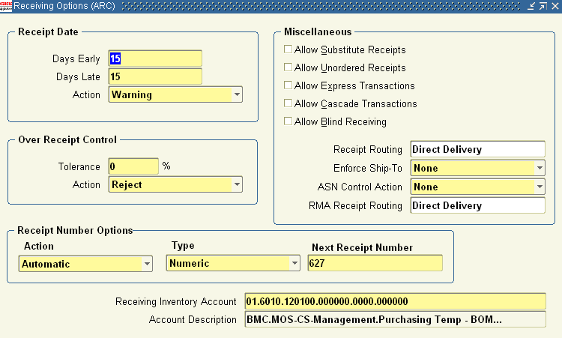
Setup Path
Purchasing>Setup>Organization>Receiving Option
Note: Each Inventory Org can help different account.
Detail Setup can refer to next page.

Slide 5
Setup Summary
Org. Name 2003.Dec – 2005.Dec | Org. Name 2006.Jan - Now | Account
ARC | RC | 6010.120100
PRJ | IP | 4010.120100
PRD | VP | 3010.120100
ACC | AC | 3010.120100
CSC | CS | 6001.120100
SEM | SE | 0000.120100

Slide 6
Agenda
Setup for 120100
Normal Practice to Reconcile
Current Issue
Issue Resolution
Sample of Adjustment
Notes:
***

Slide 7
Normal Practice To Reconcile
Check GL Journal Source on this account:
  To Run: “Account Analysis – Sub-ledger Detail (180) “
    Purchasing
    MTL
    Revaluation
    Manual ( Spreadsheet, Adjustment…)
Check Journal from Inventory
  2.1 For Balance: Run ‘Receiving Value Report’ .
    This is real time report. It is showing current balance of receiving.
    If there is data existing, pls check as following to know which PO has balance in Receiving Deck. →
  2.2 For DR&CR (Optional):
    If you want to know how 120100 Debit & Credit Amount Booked. Check Following 2 Reports:
      Receiving Account Distribution Report (A) →
      Material Account Distribution Report (B) →
Check Why Manual Journal Created.

Slide 8
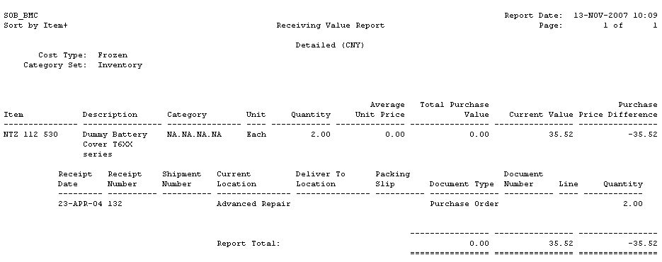
2.1 – 1: Check Report Result

Slide 9
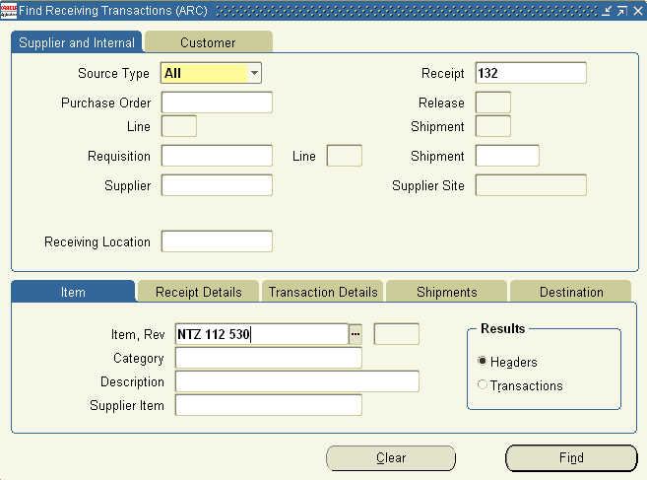
2.1 – 2 : Go To Inventory Module
Path: Inventory>Transactions>Receiving>View Receiving Transaction

Slide 10
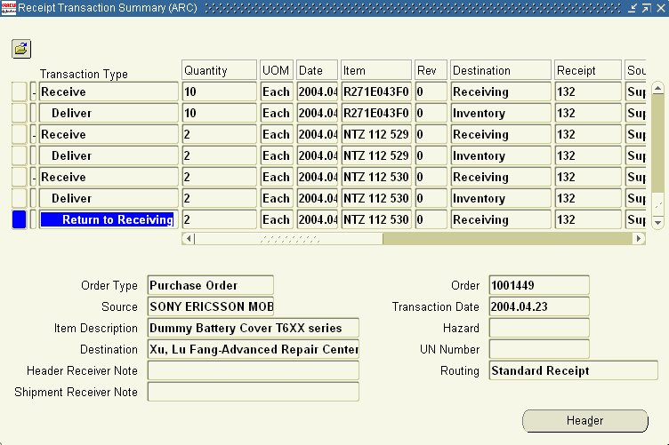
…Continued

Slide 11
2.1 – 3 : Summary
if following scenario existing, there is balance
  Receipt, but Not Delivered
  Receipt, Delivered, Return to Receiving, Not Return to Supplier.

Slide 12
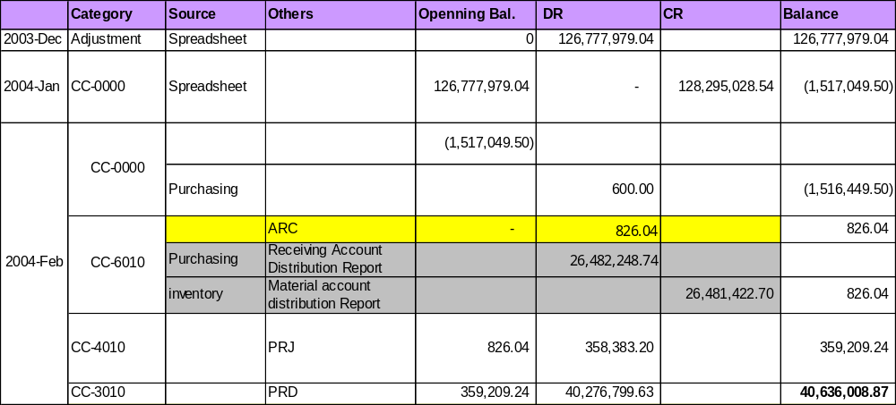
2.2 – 1 : Reconcile DR & CR
In GL Journal, You can have sum-up amount for each org on account 120100.
GL Posted without Issue.

Slide 13
2.2 – 2 : Sample:
1
Receiving:
PO:
Price USD 100
Rate: 8.7
CNY: 870
DR(120100): 870
CR: (AP Temp): 870
Receiving Account Distribution Report (A)
Std Cost: 900
2
Deliver into Stores
DR(Inventory A/C): 900
CR: (120100): 870
CR: PPV 30
  Material Account Distribution Report (B)

Slide 14
2.2 – 3 : Reconcile DR & CR
Run Following 2 Reports to reconcile this ‘total amount’.
  Receiving Account Distribution Report (A)
    This report show how “DR” is booked. Which means receiving material.
    PO Price, Converted to CNY
  Material Account Distribution Report (B)
    This report show how “CR” is booked. Which means delivered material.
    Item Std Cost.
  (A)-(B)= sum-up amount in GL.

Slide 15
Agenda
Setup for 120100
Normal Practice to Reconcile
Current Issue
Issue Resolution
Sample of Adjustment
Notes:
***

Slide 16
Current Issue
120100 Account balance is not equal to sub-ledger report balance.

Slide 17
Agenda
Setup for 120100
Normal Practice to Reconcile
Current Issue
Issue Resolution
Sample of Adjustment
Notes:
***

Slide 18
Suggestion :
Before Month-Closing, To Complete:
  Sub-ledger:
    To check how much balance existing for 12 inv org.
    Run ‘ Receiving Value Report’
    Correct (Test Firstly): Analyst each one of transaction, and make
      Receiving or Return
      May need to open Inventory Period
      May need to active or change Item Attribute as item has been disabled.
  GL:
    Has wrong opening at Dec.2003.
    Has many GL adjustment which need to confirm one by one.
At Month-Closing, Check ‘Receiving Value Report’ with Inventory Org. to keep it ‘0”.
Now Action:
  1.先将所有手工日记账都单独列示，看余额有多少
  2. 将所有库存组织的’receiving value report’都run 出来， 看为什么有余额。
  3. 子帐调整。

Slide 19
Agenda
Setup for 120100
Normal Practice to Reconcile
Current Issue
Issue Resolution
Sample of Adjustment
Notes:
***

Slide 20
Samples about how to make adjustment: (1)
Case: Receipt, Delivered, Return to Receiving, Not Return to Supplier.
  Notes: Use this data to perform a testing on CRP2.0.
  http://bmcap02.corpusers.net:8020/pls/CRP2/OracleMyPage.home
    Org: ARC
    PO Number: 1001449
    PO Line: 228
    To continue this transaction by performing a return to Supplier upon this data.
      But Following Change may happen depend on data:
      Active Item, Open Old Period
    Run this report again. Result:
    But as old period has been closed, data will post to current Period.
Summary: This is the way to update it from Sub-ledger

Slide 21
1. Run ‘Receiving Value Report’

Slide 22
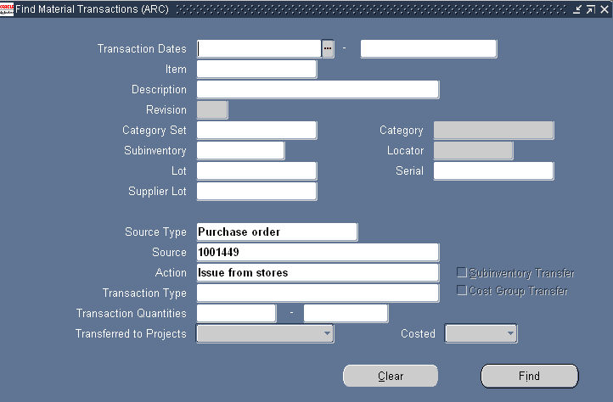
2. Check Transaction

Slide 23
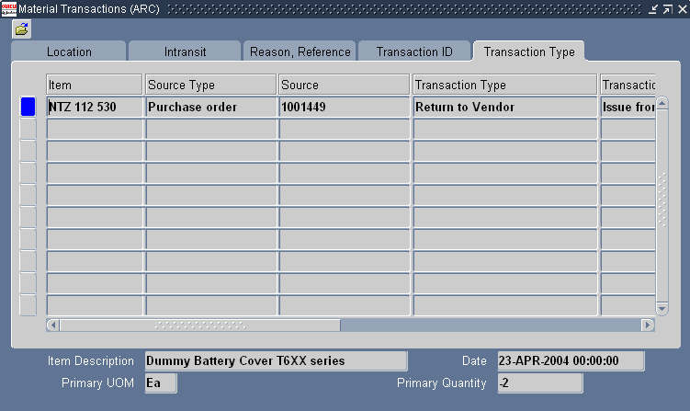
3. Make Return

Slide 24
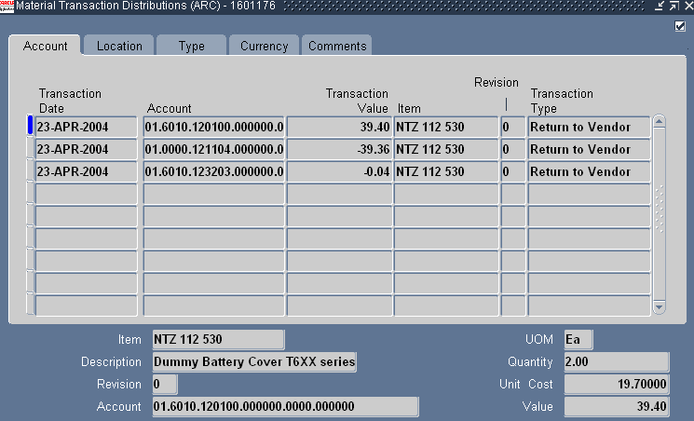
4. Check Transaction After Return to Supplier

Slide 25
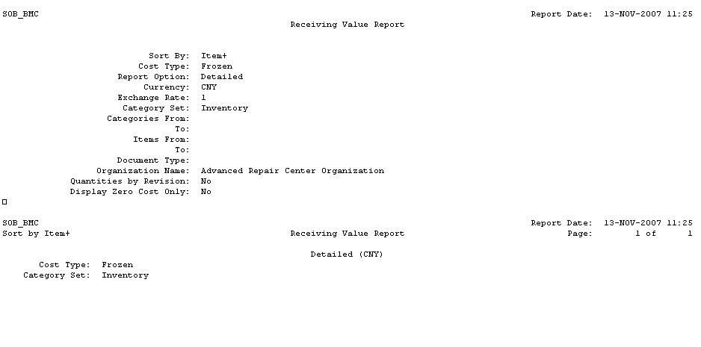
5. Check Result In CRP2.0

Slide 26
Samples about how to make adjustment: (2)
Case: Receipt, But Not Delivery

Slide 27
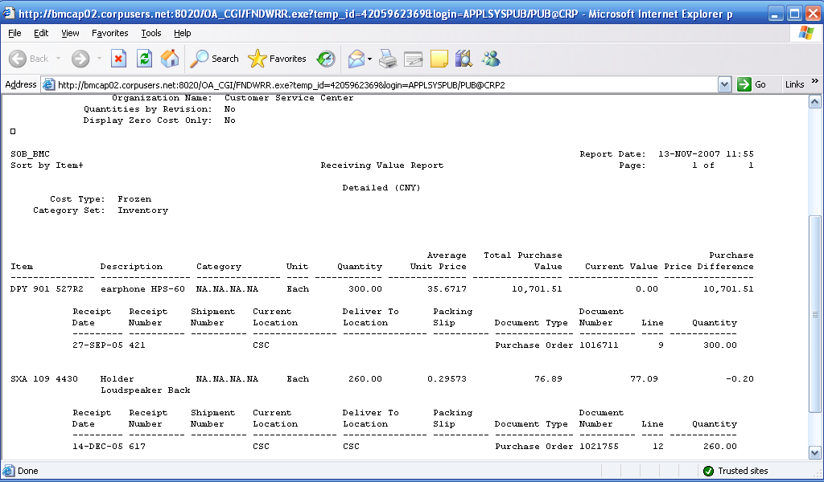
Run ‘Receiving Value Report’
CSC Org
Make Receiving For PO 1021765

Slide 28
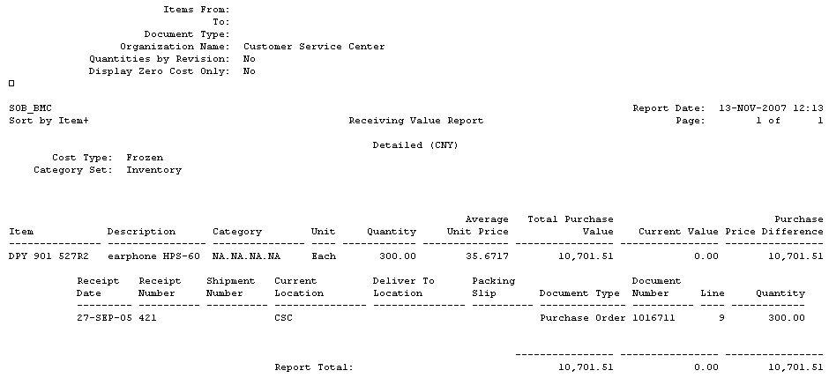
2. Run this report after delivered into stores.

Slide 29
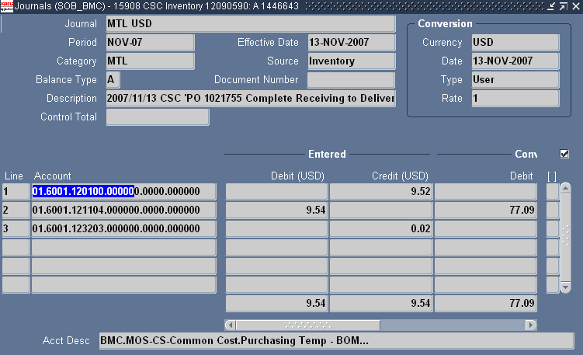
3. After Post Inventory to GL , Check GL Journal

Slide 30
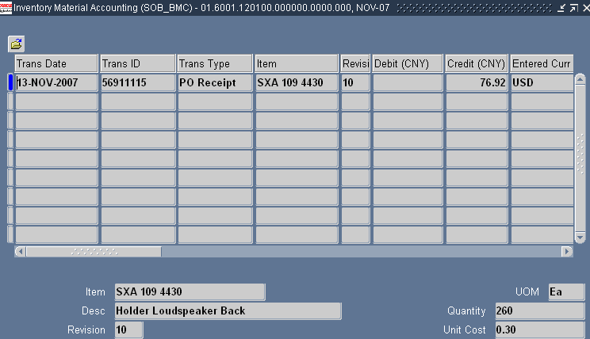
4. Drill Down to Detail in GL Journal . It’s Correct

Slide 31
Q&A

